Slide 1
Slides of Anatomy
Please note : These slides are Dr.Maher’s slides of spring 2016 and were edited by the premed Academic Team to fit the slides of spring 2019 .

Slide 2
Posterior compartment of the forearm
PS: Just imagine the greatness of your creator.
﴾ءٍ ْْ ََ َّ ه ُُ ََ َقَْتَأ يذِ هلا اللَِّ ه عَ نْ صُ ﴿

Slide 3
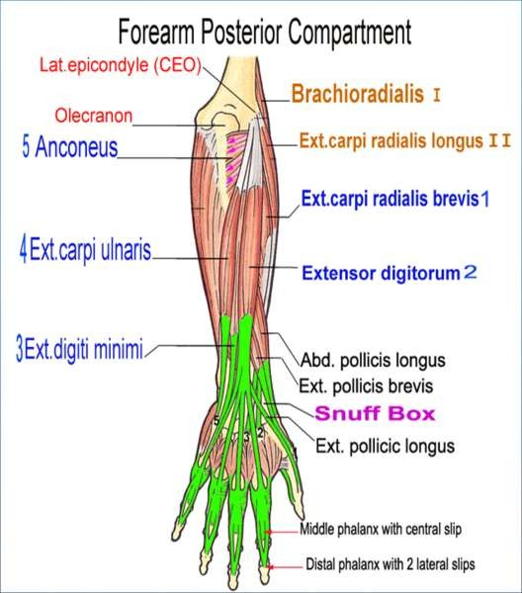

Posterior Compartment
Muscles arranged in 3 groups:
Lateral: I-II
Superficial: 1-5
Deep: 1-5
Most originates from CEO.
All supply by radial nerve.
Supply by profunda
brachii+ posterior interosseous arteries.
Most Extend wrist joint.
16

Slide 4
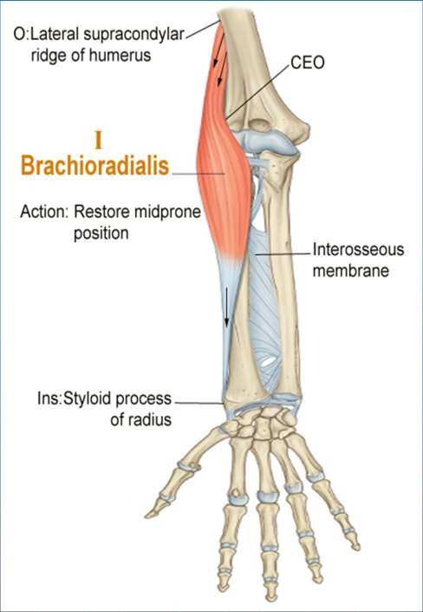
Brachioradialis
Spring 2019
Dr
.
Maher Hadidi, University of Jordan
17

Slide 5
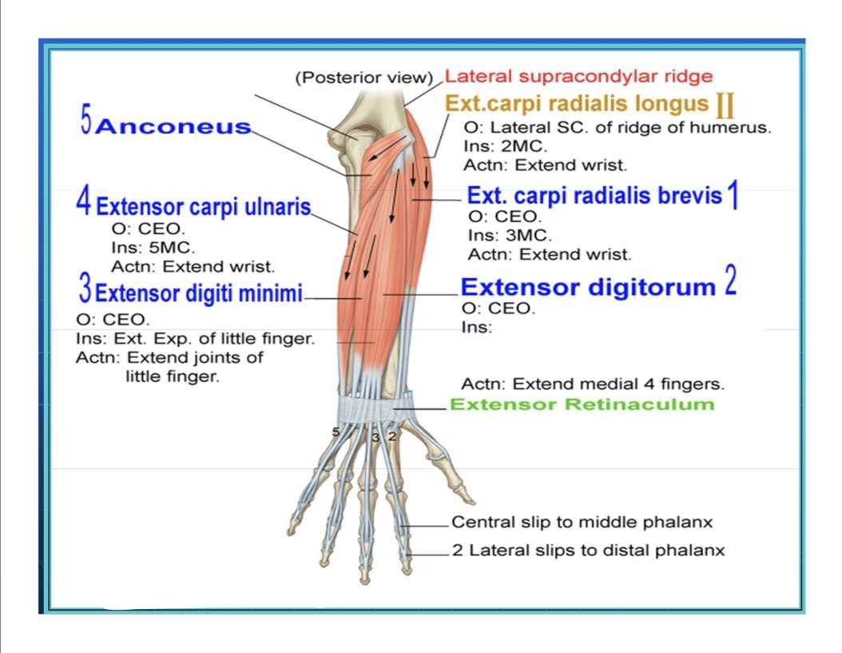
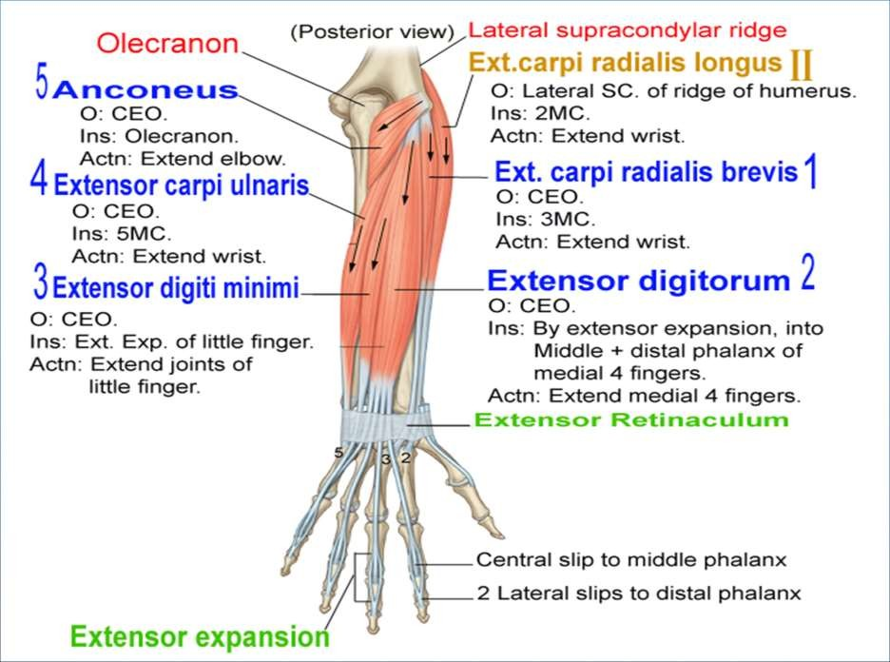



Olecranon process
O: CEO
Ins: olecranon process
Actn: extend elbow
Into middle + Distal phalanx of 4
medial fingers, by extensor expansion.
Posterior compartment
superficial group
Extensor expansion
18

Slide 6
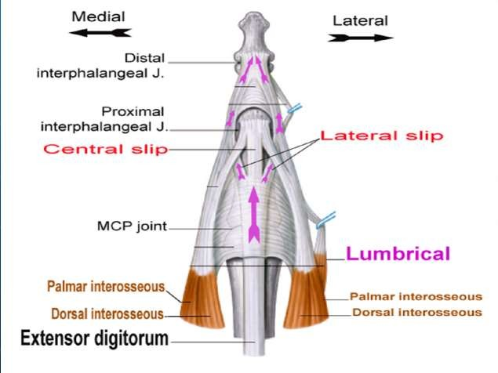
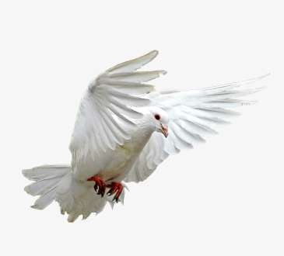
Extensor expansion
superior view
Lateral part
Central part
Spring 2019
Dr. Maher Hadidi, University of Jordan
19

Slide 7
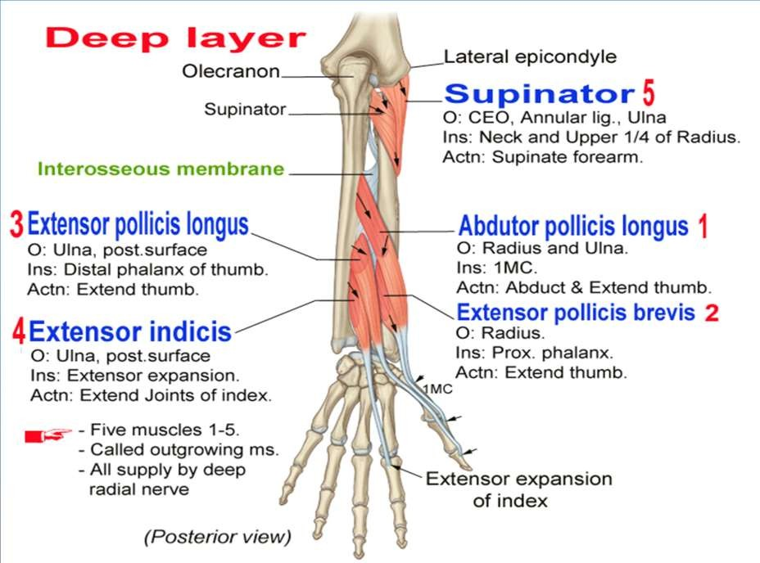
Spring 2019
20

Slide 8
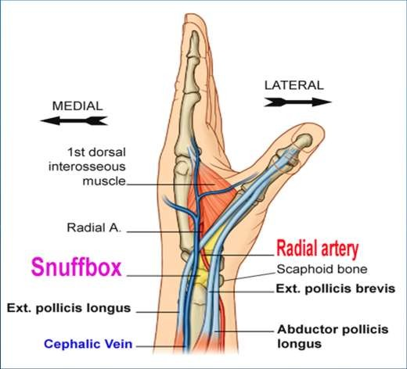
SNUFFBOX
An important clinical region on the dorsal
side of the wrist.
Borders:
Medial:
Ext. pollicis Longus.
Lateral:
  Ext. poll. Brevis
  Abd. Poll.Longus
Floor:
Scaphoid (fracture)
Content:
Radial artery (pulse).
Spring 2019
Dr. Maher Hadidi, University of Jordan
21

Slide 9
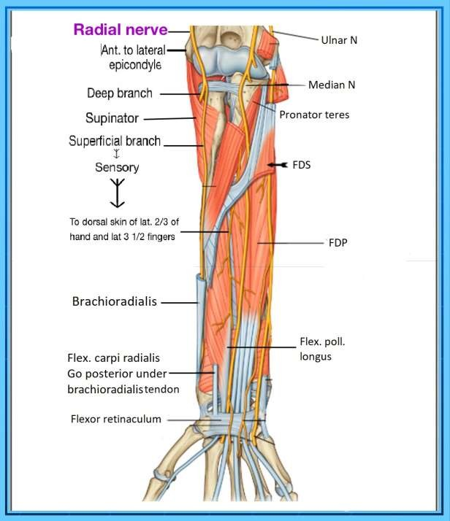
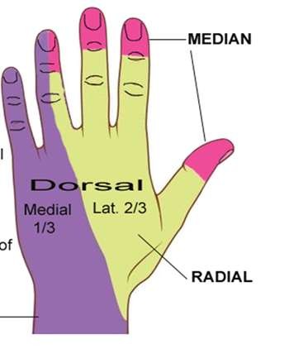
22

Slide 10
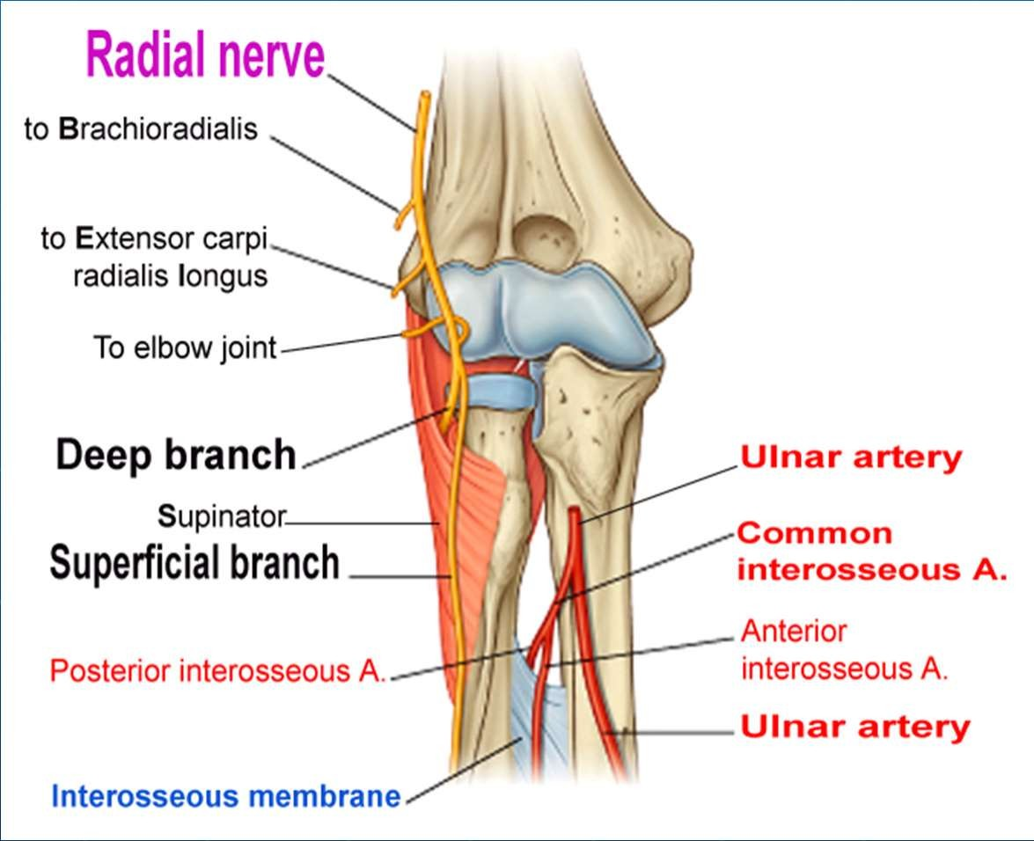
Radial nerve-1
Course:
Anterior to lateral
epicondyle.
Lateral inside cubital
fossa.
Branches:
Superficial branch.
• Deep branch .
Supply:
Elbow & wrist joint.
Forearm:
All muscles of post.
compartment.
Dorsal skin of hand.
Spring 2019
Dr. Maher Hadidi, University of Jordan
23

Slide 11
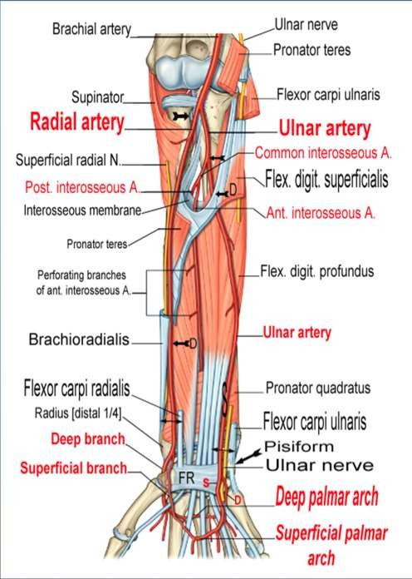
Arteries
1. Ulnar artery
Larger branch of Brach. a.
Course:
  Begin: At neck of radius.
  End: Above Flexor
Retinaculum.
Branches:
  At cubital fossa, gives
    Common interosseous A.
      Ant. Interosseous
to anterior compt.
      Post. Interosseous
to posterior compt.
  Above FR divides into 2 branches:
    Superficial branch.
    Deep branch.
Spring 2019
Dr. Maher Ha
d
idi, University of Jordan 15
24

Slide 12
Spring 2019
Dr. Maher Hadidi, University of Jordan
25

Slide 13
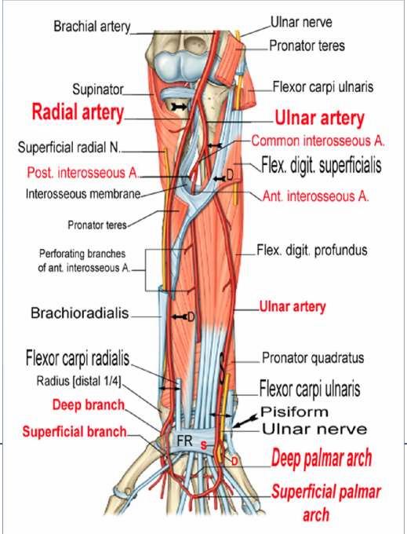
Radial artery
Smaller branch. Course:
Pass between
Brachioradialis. Flex. carpi.
radialis. Radial pulse site:
At distal ¼ of anterior surface of
radius. Divides into 2 branches
Before FR: Superficial branch. Deep branch.
²⁰¹⁹ Dr. Maher | adidi, University of Jordan 17
■
■
➢
■
Spring
H
26

Slide 14
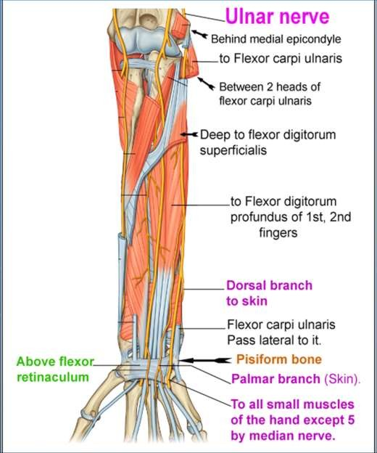

Ulnar N.
Course:
  Behind medial epicondyle.
  Between 2 heads FCU.
  Lat. to pisiform.
  Medial to ulnar A.
  Above FR.
Branches:
  Dorsal, Skin M 3rd hand.
  Palmar, Skin M 3rd hand.
  2 branches above FR.
1-Superficial (Muscles). 2-Deep branch (Ms) .
Supply:
  Elbow & wrist joints.
  Forearm: 1½ Muscles.
  Hand: All small Ms except 5.
  Skin of medial 1/3 of palm, palmar and dorsal skin
of medial 1 ½ fingers.
Spring 2019
Dr. Maher Hadidi, University of Jordan
27

